Slide 1


GROOVO
Discover. Review. Connect.
Project Owner: Christopher Bocanegra
Initial Scrum Master: Adam Gonzales
Team: Carter Wong, Srikar Chunduri, Shawn Dhillon
Notes:
speaker:Chris

Slide 2
GROOVO
Brief outline of problem/opportunity
  What's missing in today's social app ecosystem is a centralized platform where people can share their thoughts about the music they love.
  Currently, music discussions are scattered across Reddit, YouTube, Last.fm scrobbles, and TikTok.
  This app fills that gap by creating a community-driven space for thoughtful reviews and discovery.
Notes:
Speaker:Chris

Slide 3
Project Scope
High level goal(s) (for this project)
The Goal of this release is to develop a functional, minimum viable product for a social music review platform, similar to Letterboxd, but tailored to music. This app will enable users to log albums, write reviews, and discover new music through the app's social capabilities.
The key objectives of this project are:
Creating user accounts with authentication
Implementing a searchable album/song library where users can add albums/etc to their profiles
Enable users to write and read reviews
Create a simple social feed to view recent and friend activity
The app will prioritize functionality, usability, and clean design over additional features or polish
Notes:
Speaker:Chris

Slide 4
Sprint 1
Login and basic homepage
[3 pts] As a user, I want to be able to sign up and login so I can access my own profile
[8 pts] As a user, I want to see a landing page to navigate the web page
[3 pts] As a user, I want to view my profile page displaying saved albums/etc reviews
[2 pts] As a user, I want to be able to write and bio and have social customization
SPIKES: Research Frontend and backend technologies, work on design
INFRASTRUCTURE: set up github and db. Test FrameWork setup
Notes:
Speaker:Carter

Slide 5
Sprint 2
Keeping Track of Saved music
[5 pts] As a user, I want to search for albums/etc so I can find and track the music I listen to
[3 pts] As a user, I want to be able to see individual pages for each album.
[5 pts] As a User, I want to write a review and rate an album/etc so I can share my opinions.
[3 pts] As a user, I would like to create lists of albums
[3 pts] As a user, I want to like or comment on reviews.
SPIKES:Research approaches/best practices for S2 user stories.
INFRASTRUCTURE:DB Expansion,Routing and Endpoints, API connection
Notes:
Speaker:Carter

Slide 6
Sprint 3
Interacting w/ other Users
[5 pts] As a user, I want to add albums/etc to my profile or library to have my own diary of music
[3 pts] As a user, I would want a section in my profile showing my top 5 all-time favorite albums.
[3 pts] As a user, I want to be able to view reviews from other users in a feed.
[8 pts] As a user, I want to follow other users and see their activity in a feed
SPIKES:Research Spotify api/endpoints. Mapping database
INFRASTRUCTURE:DB relations setup, API Endpoints, Auth Integration
Notes:
Speaker:Shawn

Slide 7
Sprint 4
Recommendations
[3 pts] As a user, I would like to share my profile and reviews with a link
[5 pts] As a user, I would like to see an album of the week in my homepage to get a recommendation
[5 pts] As a moderator, I would like to be able to remove comments/posts of other users.
SPIKES:Moderation,share public profile URLS, UI/UX
INFRASTRUCTURE:Public Profile Routing,Role-based permissions
Notes:
Speaker:Shawn

Slide 8
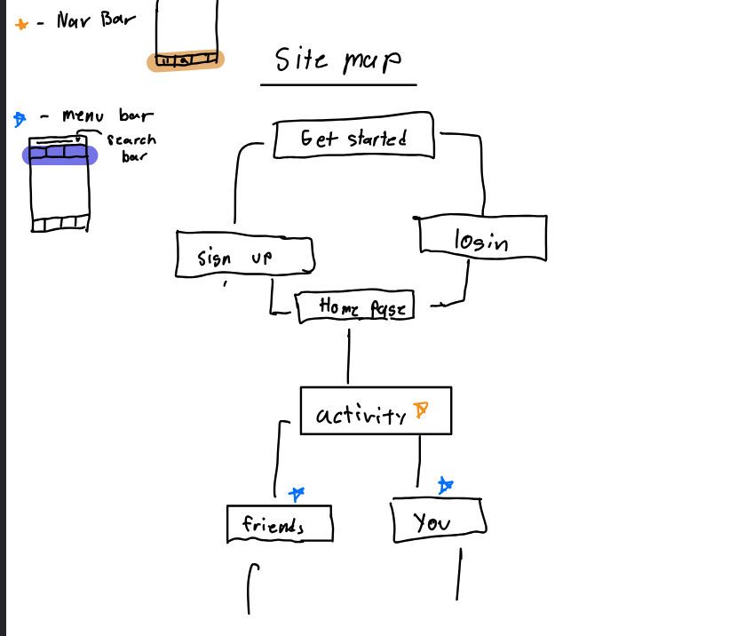
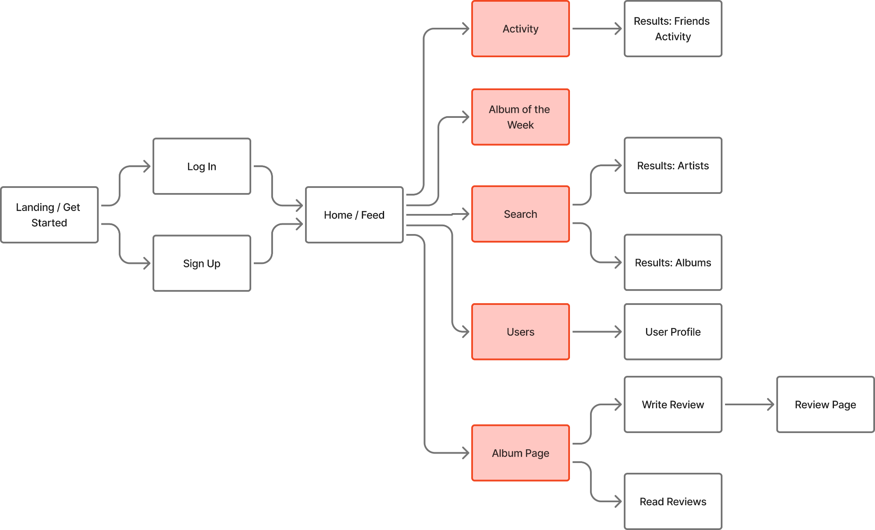
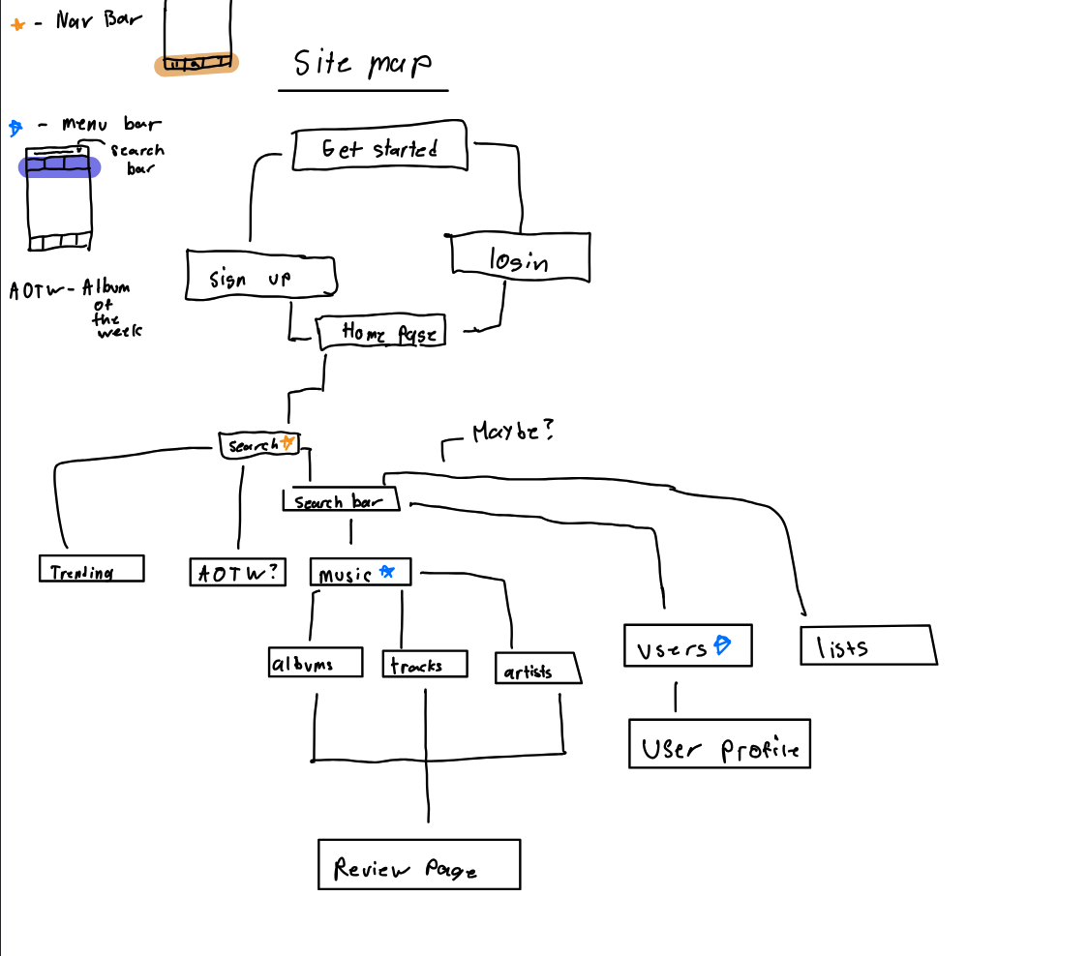
Architecture
Notes:
Speaker:Adam

Slide 9
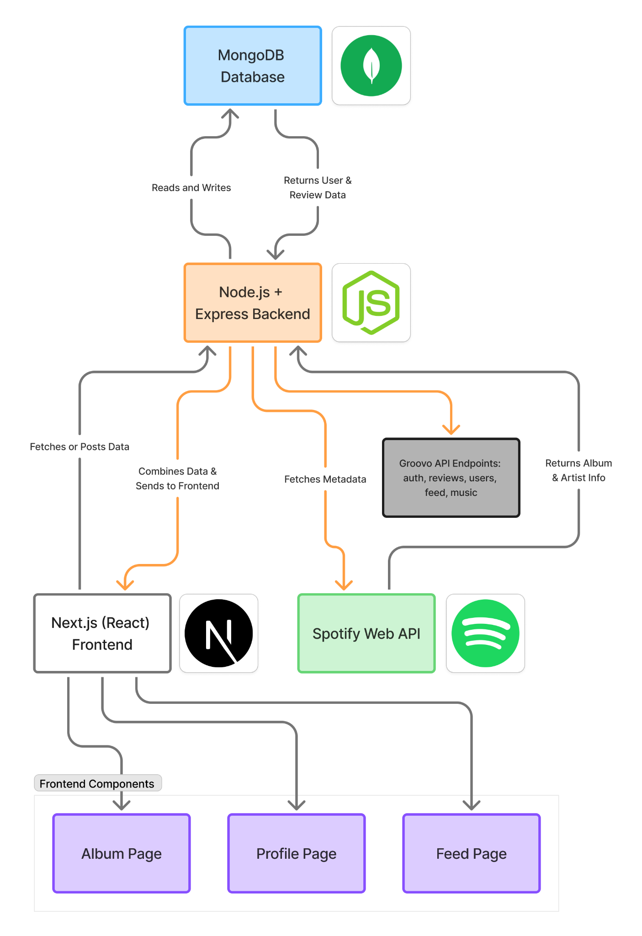
Technologies
Programming Languages:
JavaScript, HTML, CSS
Database:
MongoDB
Backend:
Express.js (Node.js)
Frontend:
Next.js (React Framework)
External API:
Spotify Web API (for album, artist, and track data)
Hosting / Deployment:
Vercel (frontend), MongoDB Atlas (database)
Notes:
Speaker:Adam

Slide 10
Challenges/Risks
[Challenge/Risk 1]Using a shared github repository effectively e.g. complex feature set
[Challenge/Risk 2]Retrieving info from the database to review other users’ reviews e.g. unfamiliar technology
[Challenge/Risk 3] Combining the individually designed features of the project into a functioning app (similar to Risk 1 above)e.g. new/immature technology
Notes:
Speaker:Srikar

Slide 11
MVP
The MVP demo will demonstrate the following flow:
User registration and login.
Searching for and adding an album/song to library
Writing and viewing reviews
Profile Personalization
Viewing a basic social feed
A landing page
Notes:
Speaker:Srikar

